Slide 1

Data Analysis on Indian Premier League
Project By:
OMKAR SHITOLE
SHIVANI CHAVAN
HARIHARAMMURTHY
KRISHNAMOORTHY
GROUP 1
Analysis of IPL match 2022 by using python packages like pandas, numpy, matplotlib, seaborn, sweetviz, and pandas profiling

Slide 2

INTRODUCTION
Ever thought about how important big data is to cricket? Cricket is not an exception, since it too generates a data that may be examined for further understanding.
Analyzing data in cricket is beneficial not only to the players, but also to the team, because it allows everyone to discover and overcome their flaws. The information can also assist organizers understand their finances.
Despite India is the richest cricket market, it is not the only one. As a consequence, many are willing to pay a high price to witness their idols in action in a live match. It goes without saying that watching a sporting event live differs greatly from viewing it on television. These organizations make income by selling tickets and television rights to television networks.

Slide 3
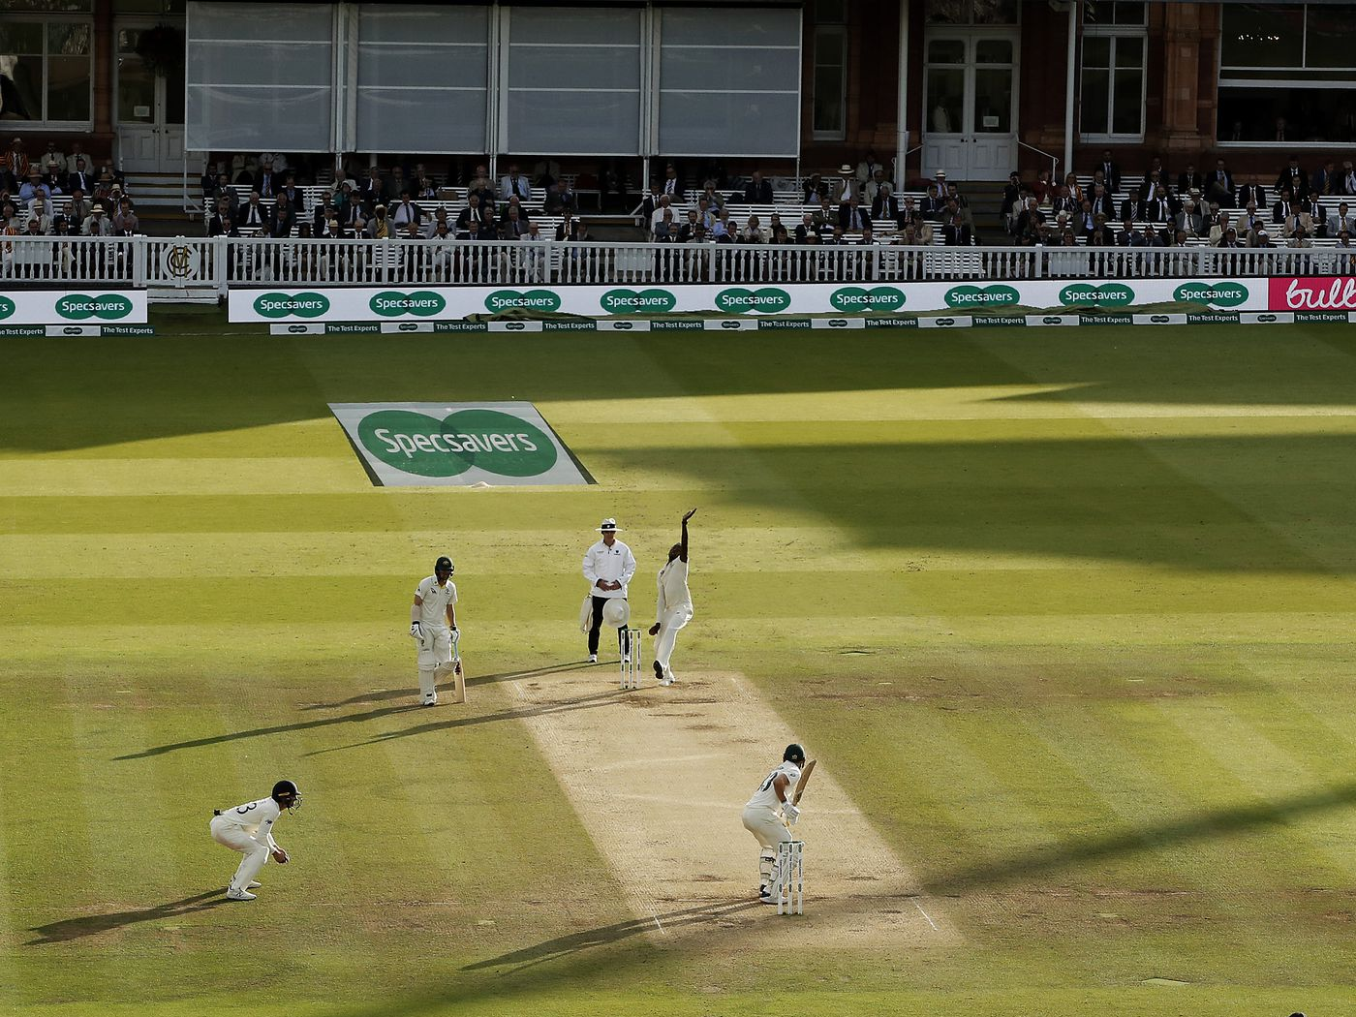
About cricket
Cricket is an outdoor sport played with a bat, a ball, and stumps. This game is generally played between two teams and the team that has the most runs wins. Cricket is a run-based sport since it is played across 22 yards of a field. In addition, "umpire" are there to settle disagreements and make fair rulings. It's worth celebrating if a bat achieves more than 100 runs or a ball strikes the wicket. There is a significant amount of anticipation about the sport across the world, and it is England's major sport.

Slide 4

ABOUT INDIAN PREMIER LEAGUE (IPL)
The Indian Premier League (IPL) is a competitive men's Limited - overs cricket league conducted between April and May of each year featuring 10 teams from ten Indian cities. The Board of Control for Cricket in India (BCCI) established it in 2007.

Slide 5
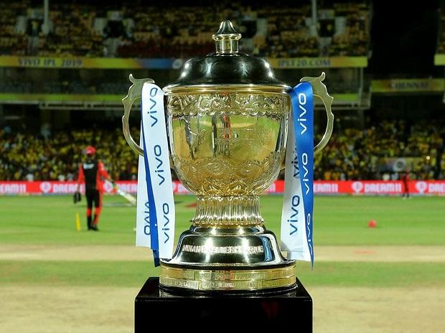
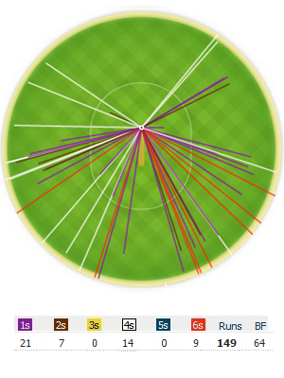
Problem statement
We ran an inferential statistical analysis on two separate datasets to see what characteristics may influence a team's ability to win. The parameters we selected to examine are as follows: win rate, number of games played, pre-game coin toss result. We were also interested about other criteria, such as the individual statistics.

Slide 6
DATA VISUALIZATION LIBRARIES AND DATA SETS
This Python notebook analyzes IPL matches of 2022 using Python tools like pandas, numpy, matplotlib, seaborn, plotly.express and Statistics. We employ two databases in this notebook: IPL Matches of2022 and IPL Ball-to-Ball Data of 2022.

Slide 7
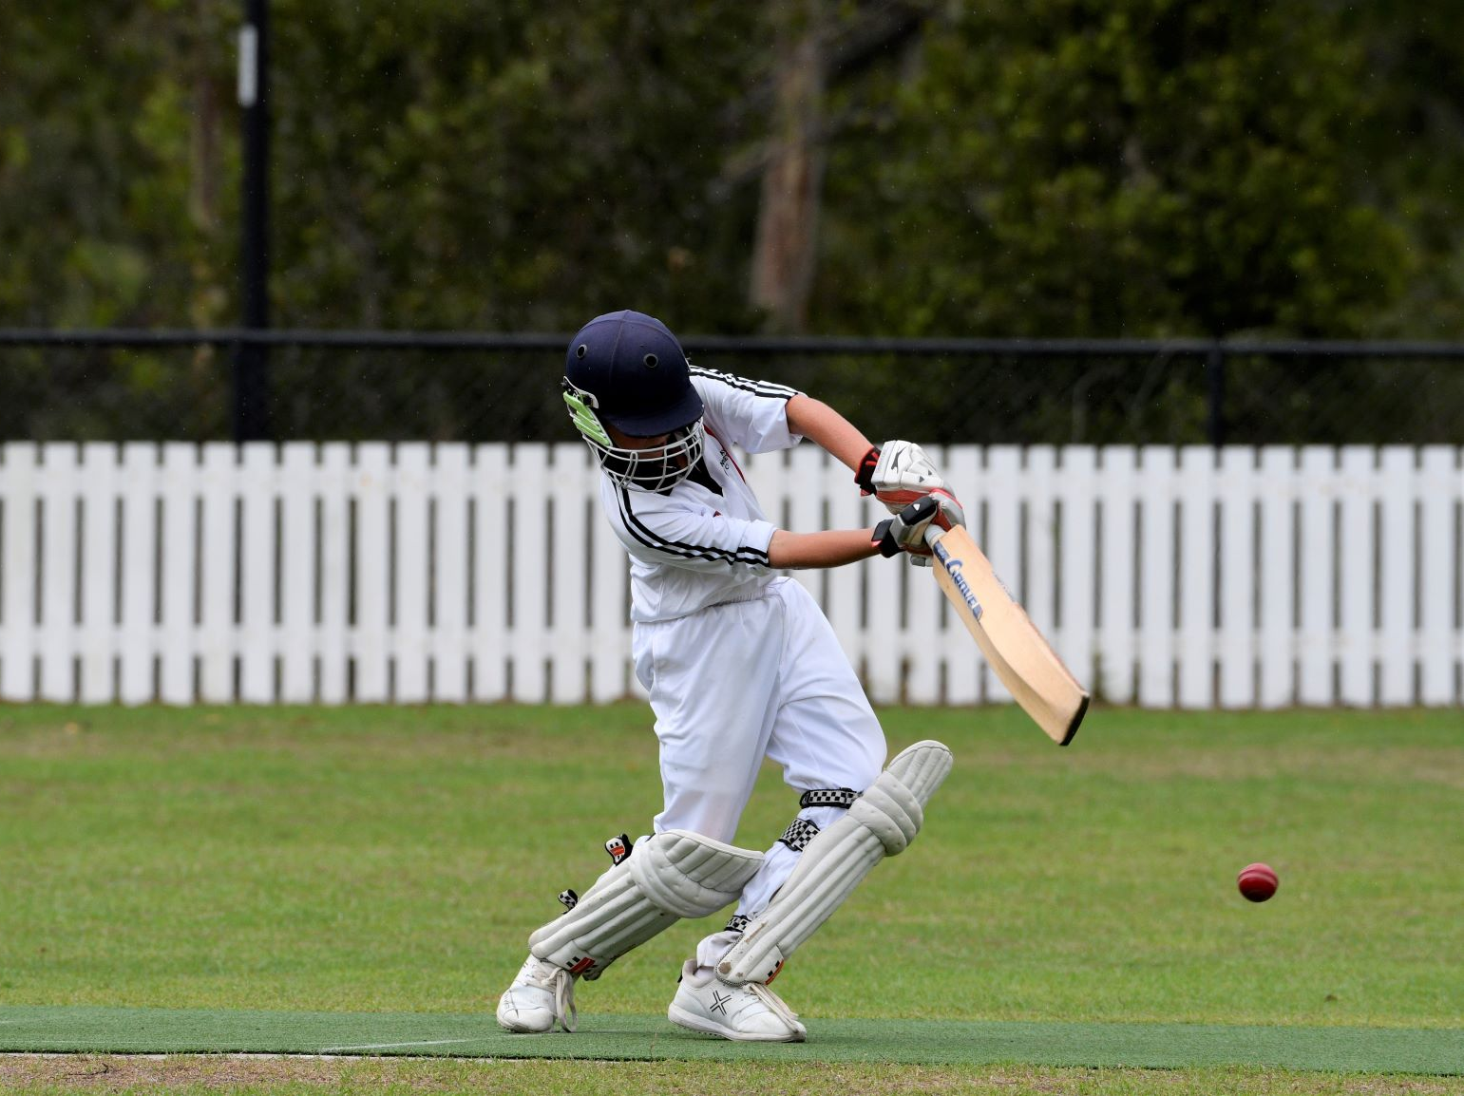
EXPLORATORY DATA ANALYSIS (EDA) ALONG WITH THEIR RESPECTIVE VISUALIZATION
.

Slide 8
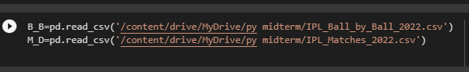
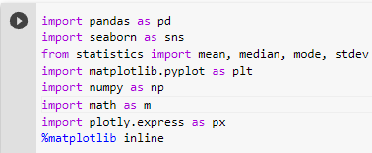
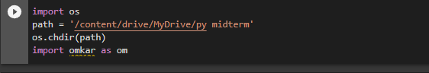
Mounting Drive with Colab Reading dataset from CSV file Importing Library

Slide 9
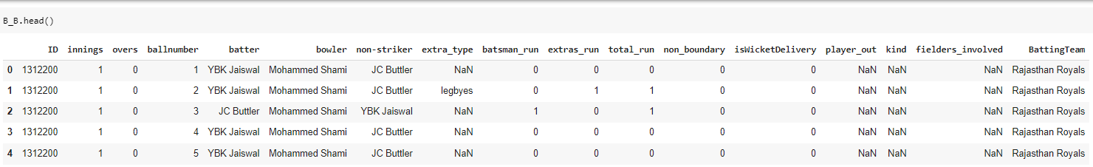
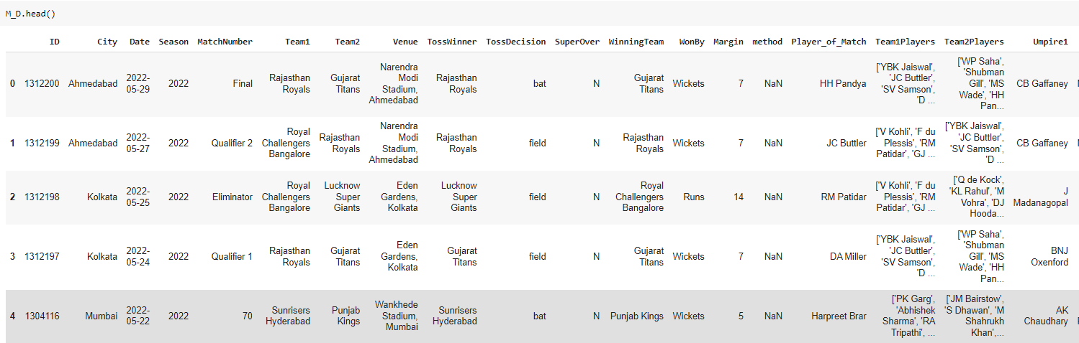
Understanding the Dataset
This function returns the first n rows for the ball by ball dataset based on position top
This function returns the first n rows for the IPL matches dataset based on position top

Slide 10
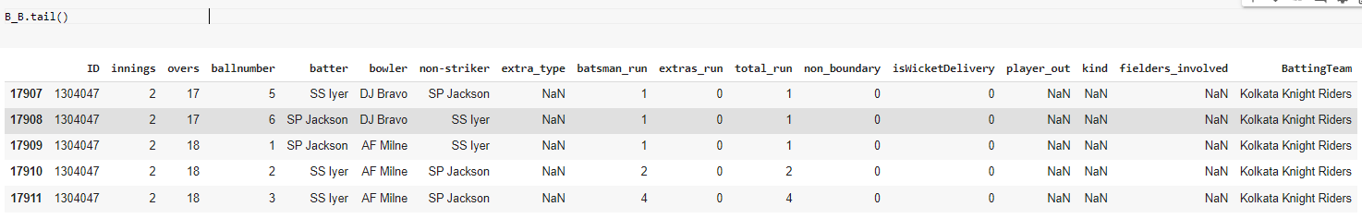
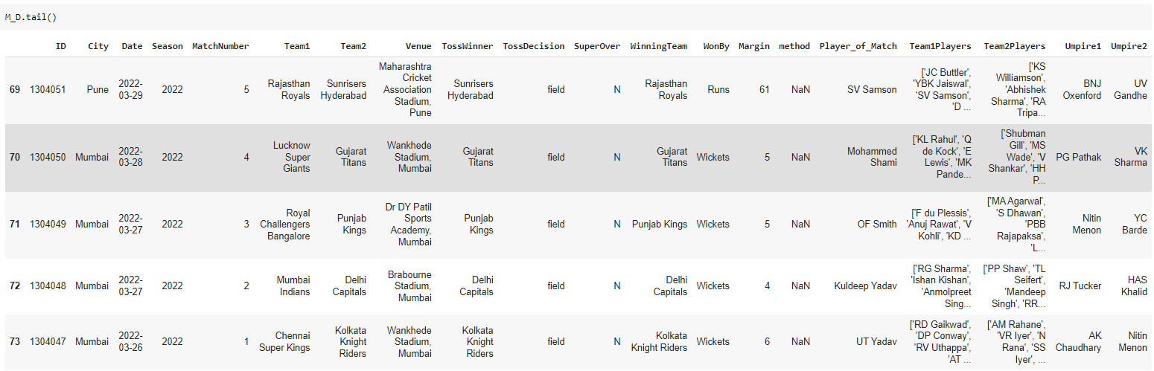
UNDERSTANDING THE DATASET
This function returns the first n rows for the ball by ball dataset based on position down
This function returns the first n rows for the IPL matches dataset based on position down

Slide 11

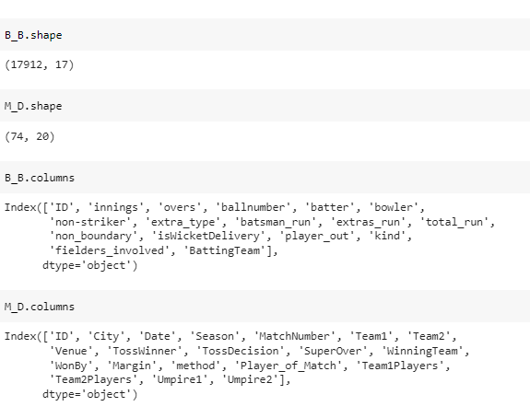
Understanding the Dataset
The following code describes the data

Slide 12
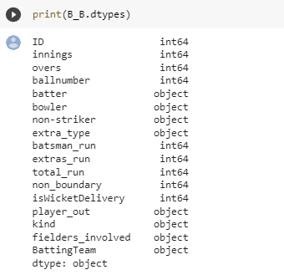
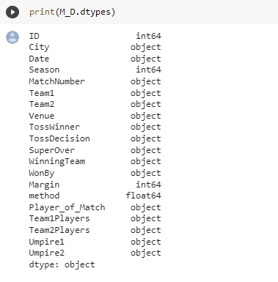
Understanding the Dataset
THE FOLLOWING SHOWS datatypes of ball by ball daTA
THE FOLLOWING SHOWS DATATYPES OF IPL MATCHES DATA

Slide 13
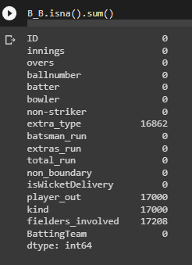
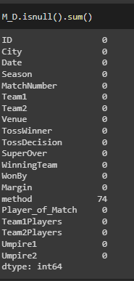
Checking Null Values

Slide 14
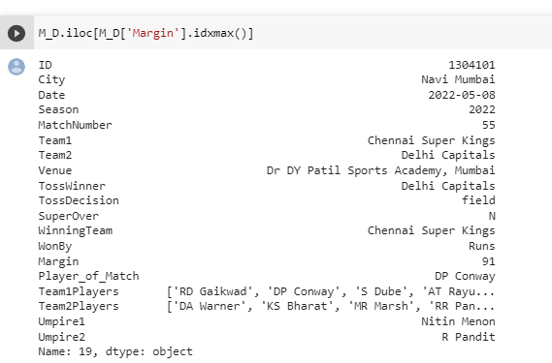

Team won by highest Margin
This following data shows the team which won by highest number of margins

Slide 15
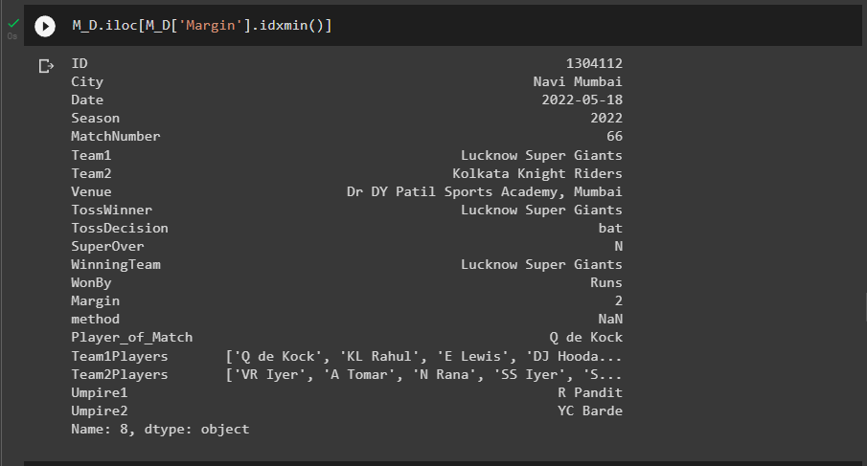

Team won by Minimum Margin
This following data shows the team which won by Minimum number of margins

Slide 16
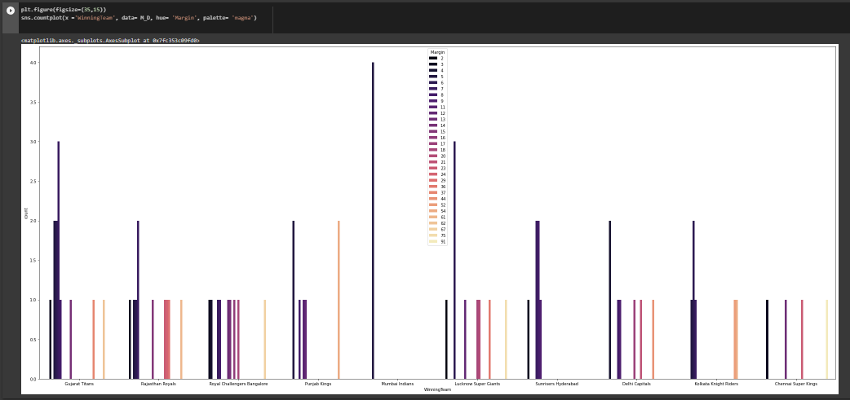
Count plot for winning team and Margin
We have use count plot to show the data visualization for winning team with respect to margin.

Slide 17
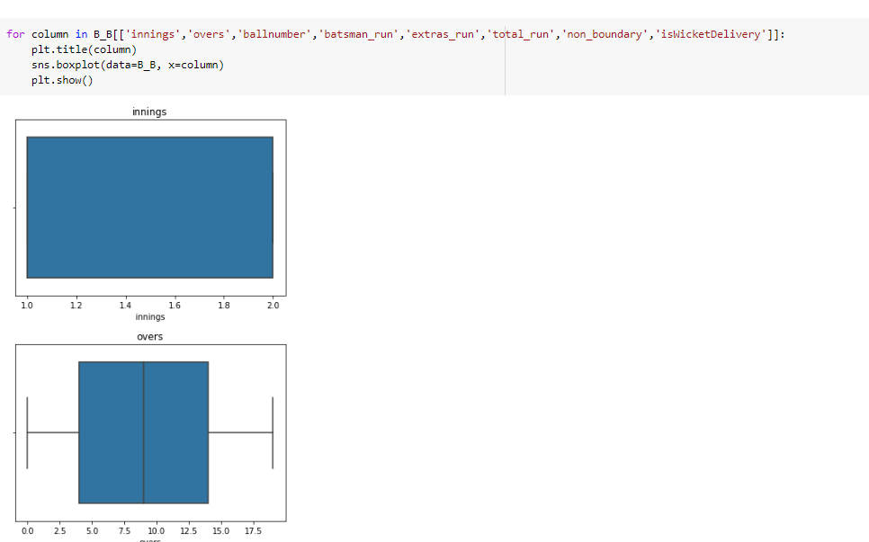
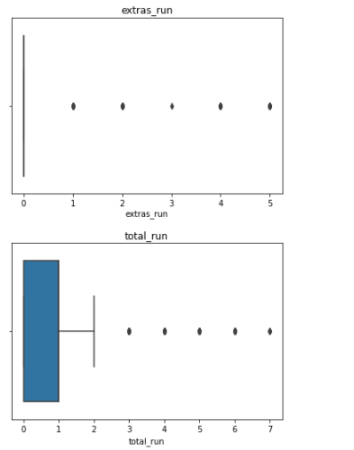
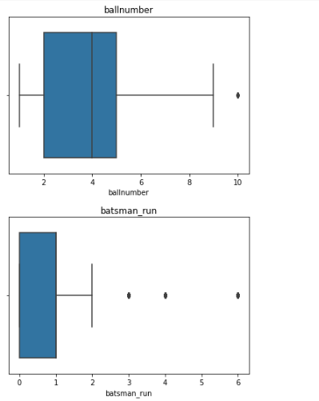
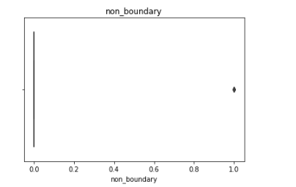
Checking for Outliers using Boxplot
The following diagram shows the boxplot for ball by ball data
In this data there is no continuous variable so there are no outliers

Slide 18
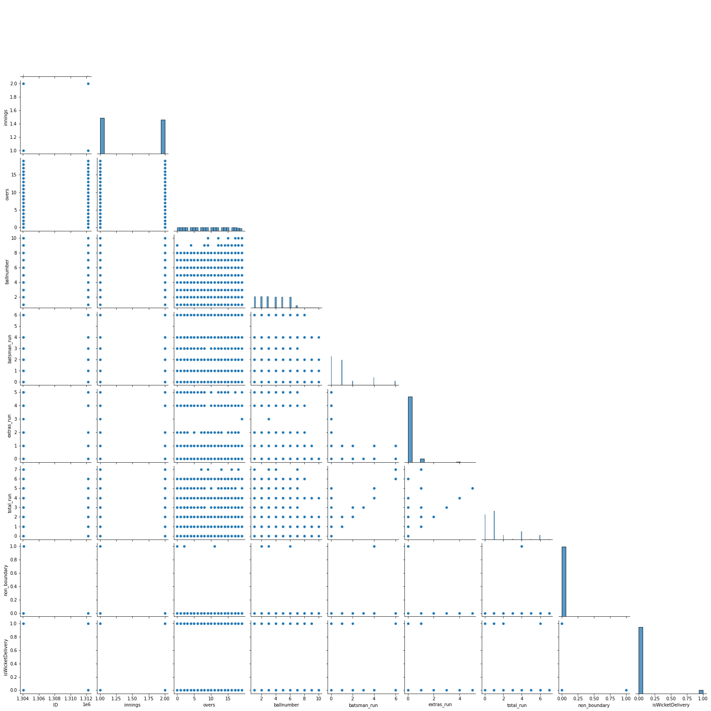
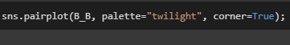
VISUALIZATION OF DATASETS
We have used the Pair plot to study the relationship of each and every column with each other and foundout
there is a linear relationship between batsman_run,extra_run and total_run.
PAIR PLOT

Slide 19
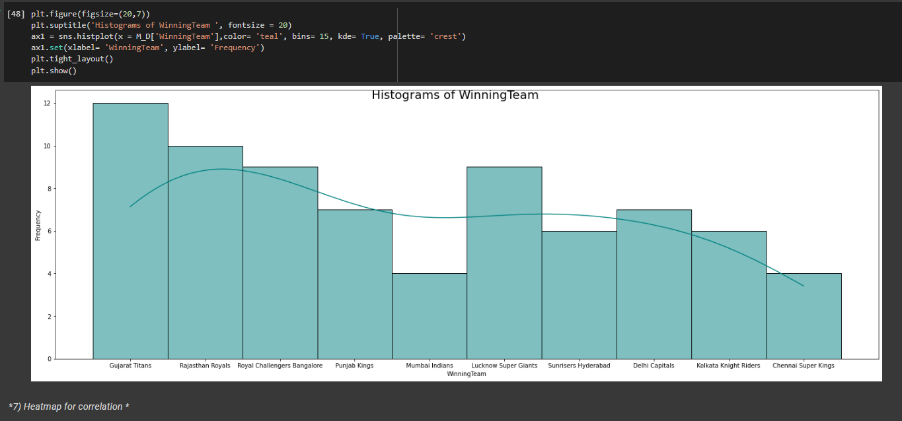
Histogram for Winning Team
The histograms show the number of matches won by each team

Slide 20
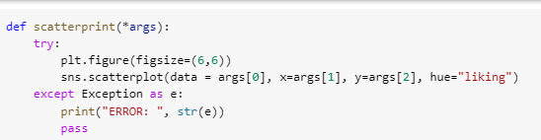
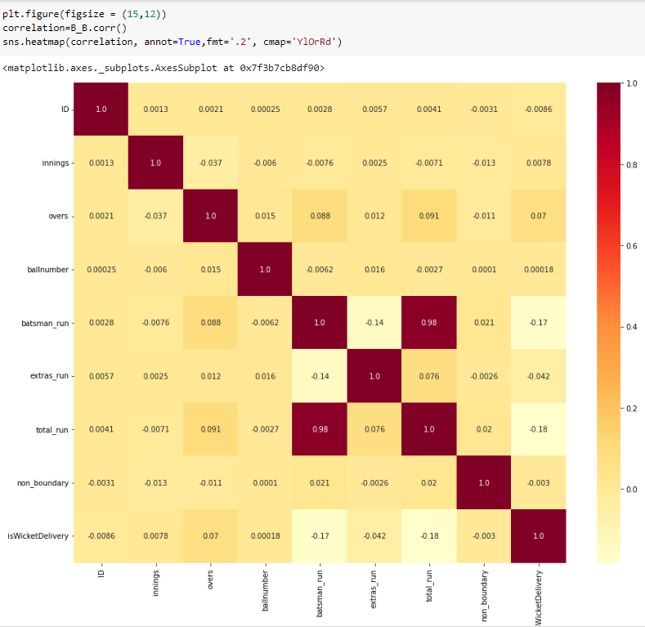
Heatmap for correlation
The following heatmap use find correlations between two variables in our dataset as we can see in our heatmap there is a strong correlation between two variables Total run and batsman run

Slide 21
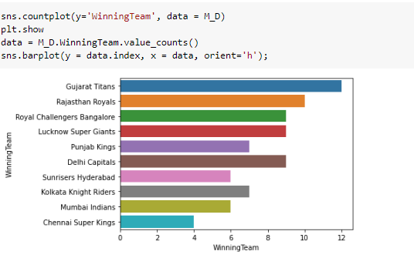

Winning matches of each team
From this graph we can see that Gujarat Titans have highest win of 12 matches followed by Chennai Super kings is the least winning team showcased in countplot.

Slide 22
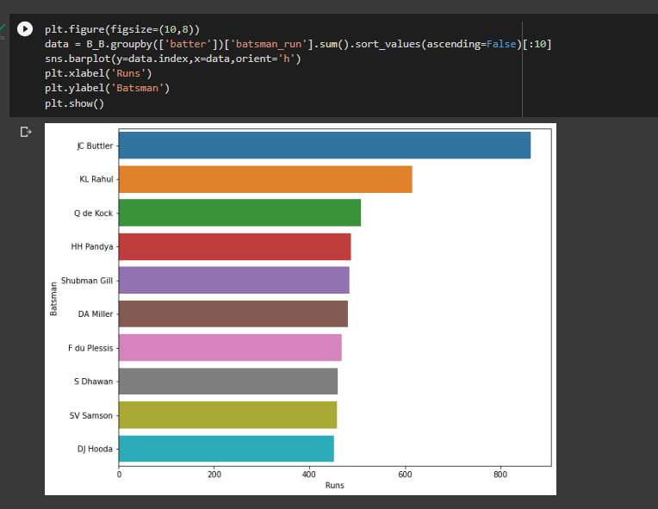

Most IPL Run By A Batsman

Slide 23
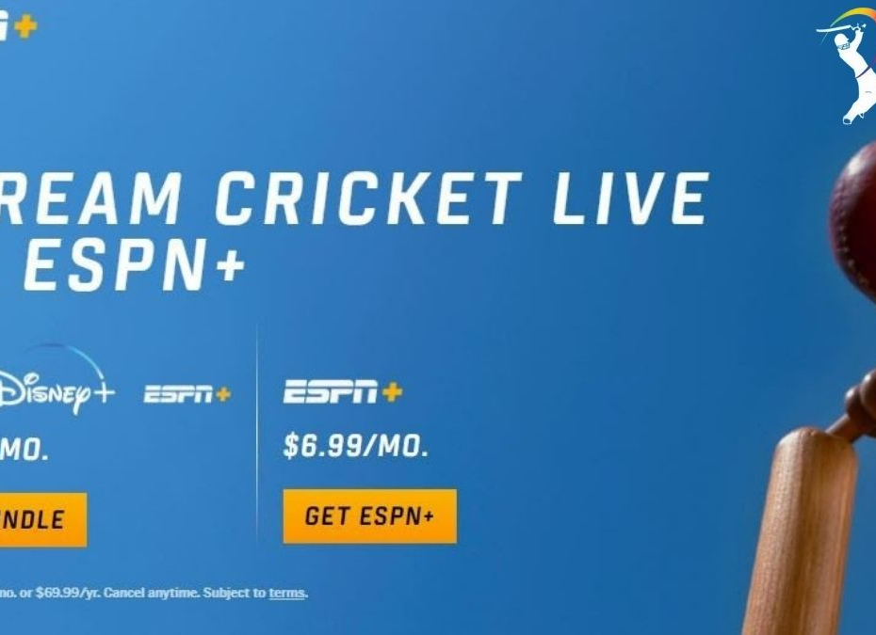
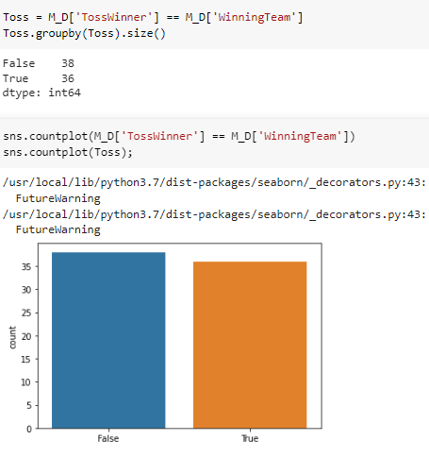
TOSS DECISION IN WHICH TOSS WINNER IS THE GAME WINNER
From the following diagram we get to know that 38 times the toss winning teams had lost the matches whereas only 36 times teams had won the both toss and the match

Slide 24
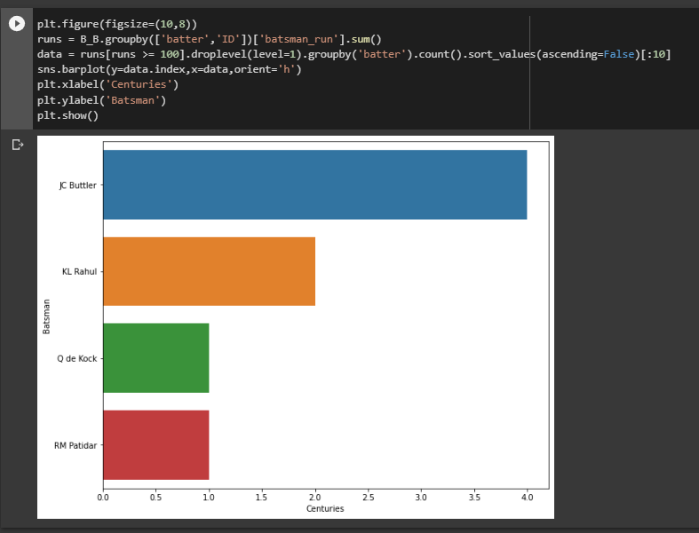
Most Centuries by Player

Slide 25

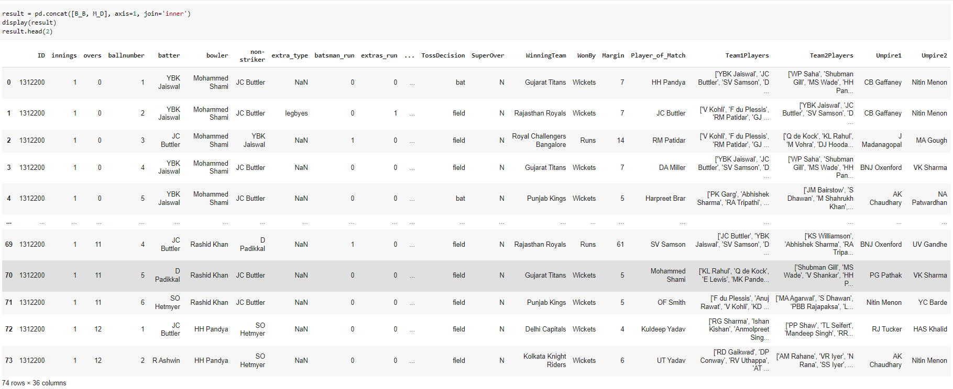
Merging Two Data set
The following data merge between ball by ball data set and ipl matches dataset

Slide 26
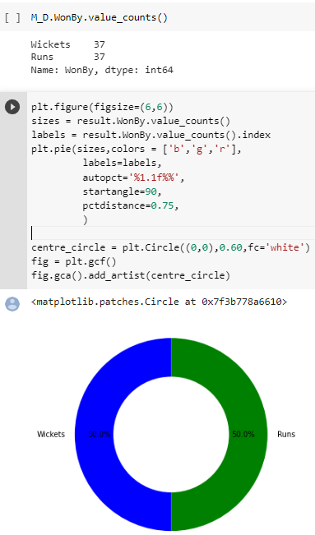
Match winning types
The following pie chart shows the 50% of matches won by wickets and 50% of matches won by runs

Slide 27
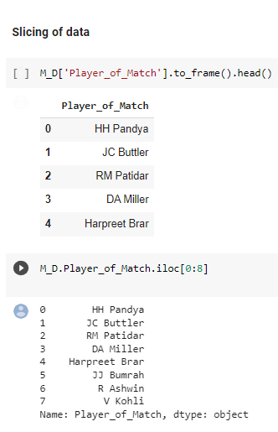

Slicing of Data
The following data shows the records of player who won most Man Of Match awards

Slide 28

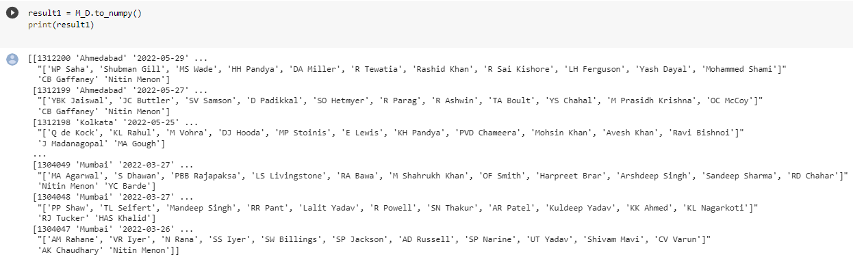
Upload data to Numerical Python (NumPy)
The following data shows the conversion of matches dataset into NumPy

Slide 29

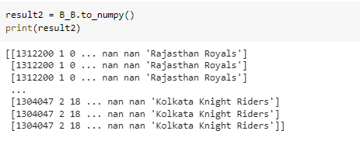
UPLOAD DATA TO NUMERICAL PYTHON (NUMPY)
The following data shows the conversion of ball by ball dataset into NumPy

Slide 30

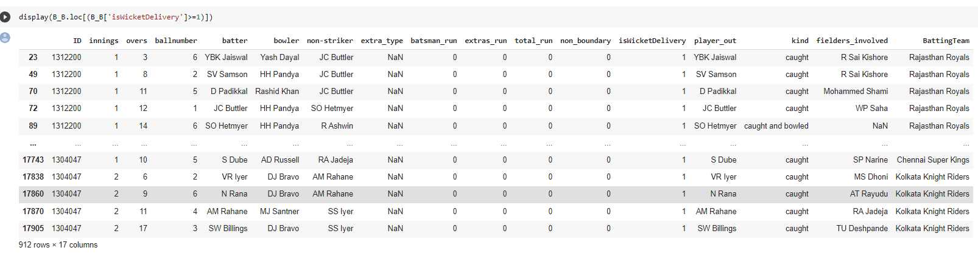
Use conditions and segregate the data based on the condition
The following data shows the wicket delivery ball to the batsman

Slide 31
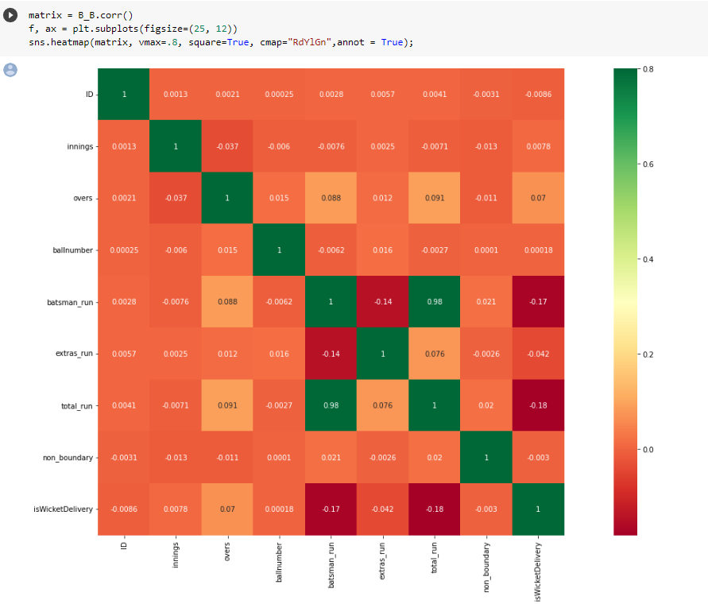

Matrix graph
The following graph shows the heatmap of ball by ball datasets and correlation between the columns.

Slide 32

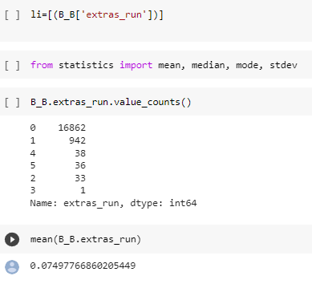
Extras run from statistics
This following data shows the count of extras run given by the teams in the overall season

Slide 33
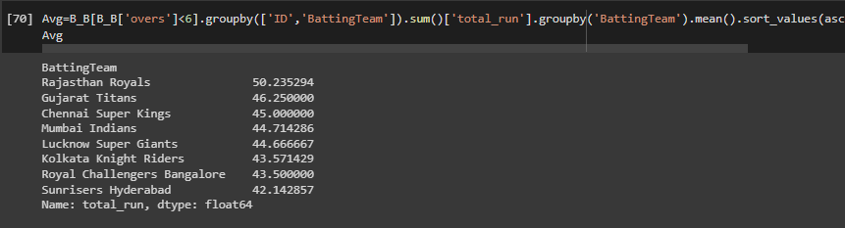
Average Run By Teams in Powerplay

Slide 34
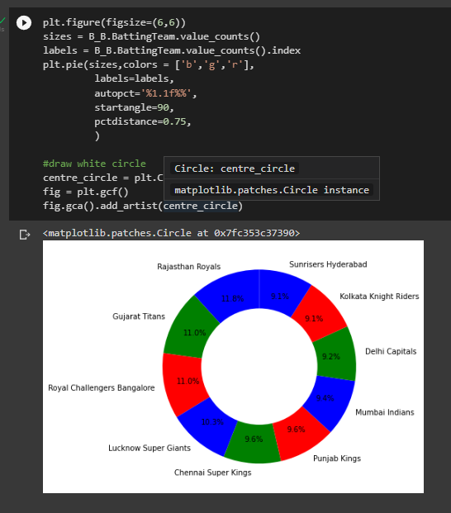
Pie chat of total run scored in this season by each team in percentage

Slide 35

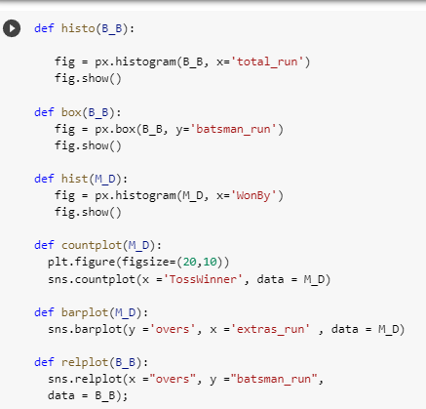
Functions for plot
These following code shows the histogram for total run, boxplot for batsman run, histogram of Wonby, countplot of Tosswinner, Barplot of over and extras run, relplot of between overs and batsman run

Slide 36
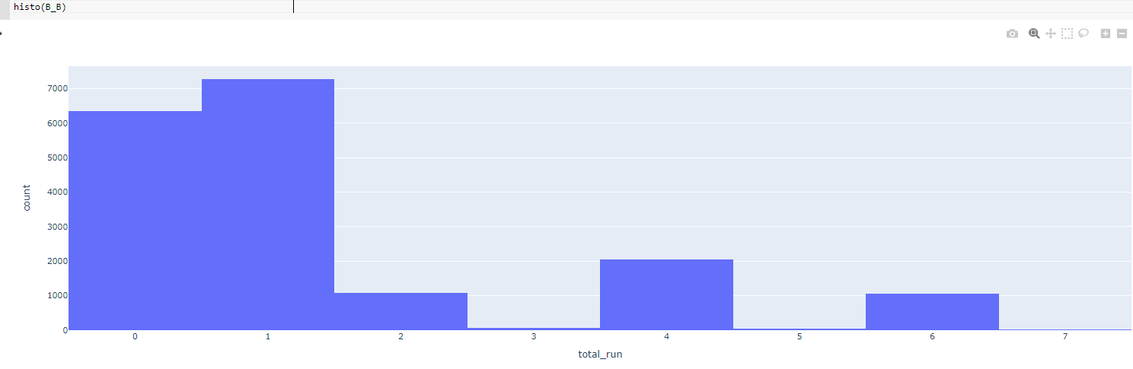
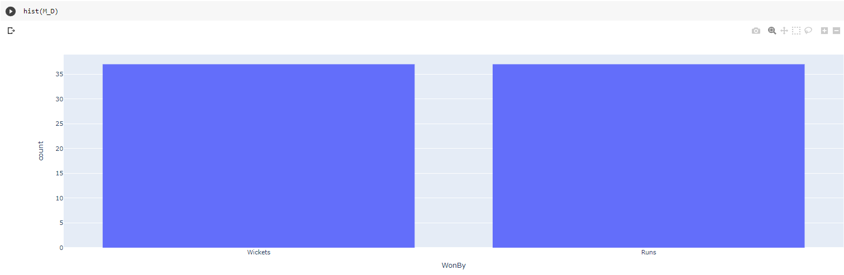
Visualization of datasets
The following data shows the histogram of total runs in ball by ball dataset and won by in IPL match dataset
HISTOGRAM

Slide 37
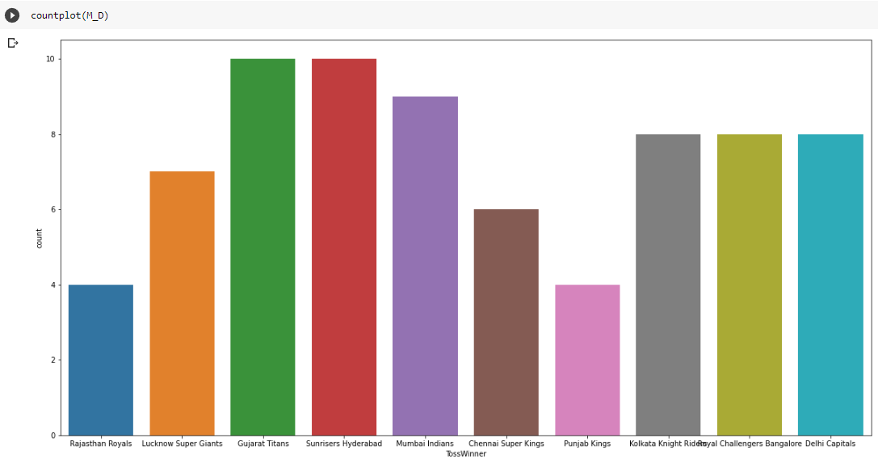
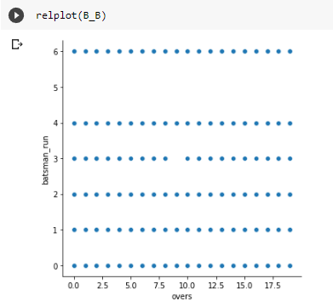
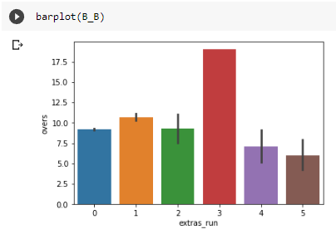
VISUALIZATION OF DATASETS
Count plot for Tosswinner of Ipl matches dataset
Relationship plot between overs and batsman run
Barplot for extra runs of ball by ball dataset

Slide 38
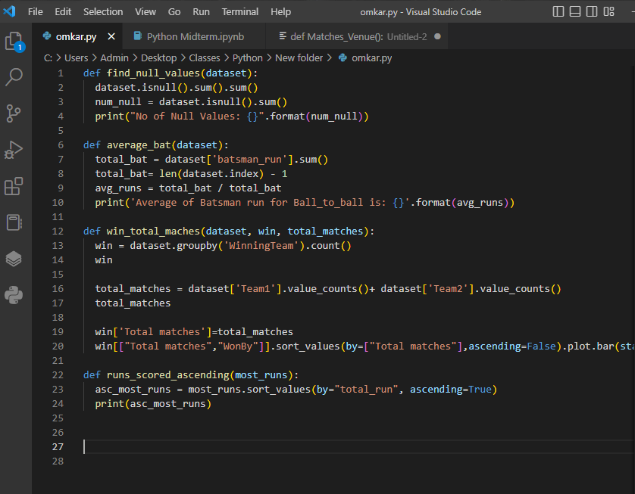
Functions Used

Slide 39


Total Number of Matches Played and won by each team

Slide 40

Function
Runs scored by both team in a match in ascending order

Slide 41


Finding Null values using function

Slide 42

RESULT
Gujarat titans Won Most games in IPL that is the reason they won the cup of IPL 2022.
The team which lost number of tosses had 2% extra chance of winning the game.
In IPL 2022 the maximum margin of winning a game was 91 runs which was won by Chennai Super Kings and the minimum margin of winning a game was by 2 runs which was won by Lucknow Super Giants.

Slide 43
Conclusion:
Taking all the factors in account we found likely correlationship between batsman run and total run. As the batsman run increases the team total increases as we can see in the heatmap. All this are just a fraction of data analysis performed on this data set there are even more thing we can learn from the past. Hence, we can only Imagine how all this data analysis done on these data sets could be used by the Team management and the Event Organizers to work their shortcomings and work more efficiently.

